Slide 1
IRIS FLOWER CLASSIFICATION
By; Benson Kinyua.

Slide 2
Project Overview
The Iris Flower Classification project aims to develop a data-driven solution for accurately categorizing iris flowers based on their botanical features. This project holds significance in various domains such as botany, agriculture, and environmental studies, where accurate identification of iris species can aid in research, conservation efforts, and horticultural practices. By leveraging machine learning techniques, this project seeks to automate the classification process, providing a reliable and efficient means of identifying iris species.

Slide 3
Business Objectives:
* Accuracy Improvement: Develop a classification model with high accuracy to ensure reliable identification of iris species.
* Efficiency Enhancement: Automate the classification process to save time and resources compared to manual identification methods.
* Scalability: Create a scalable solution capable of handling large volumes of iris data for real-time or batch processing.
* Generalizability: Develop a model that can generalize well to unseen iris samples, ensuring robust performance across diverse datasets.
* Interpretability: Strive for model interpretability to provide insights into the features driving classification decisions, aiding in botanical research and analysis.

Slide 4
Stakeholders:
* Botanists and Biologists: Require accurate species identification for research, conservation, and ecological studies.
* Agriculturalists and Horticulturists: Benefit from precise classification for breeding programs, cultivation, and crop management.
* Environmental Organizations: Rely on accurate identification for monitoring and preservation efforts of iris species in natural habitats.
* Data Scientists and Machine Learning Engineers: Responsible for developing, optimizing, and deploying the classification model.

Slide 5
Data Understanding:
The data set is available at https://archive.ics.uci.edu/ml/datasets/iris, the errors are modified as well. It consists the following information for 150 samples,
1. sepal length (in cm)
2. sepal width (in cm)
3. petal length (in cm)
4. petal width (in cm)
5. class:
- Iris Setosa
- Iris Versicolour
- Iris Virginica

Slide 6
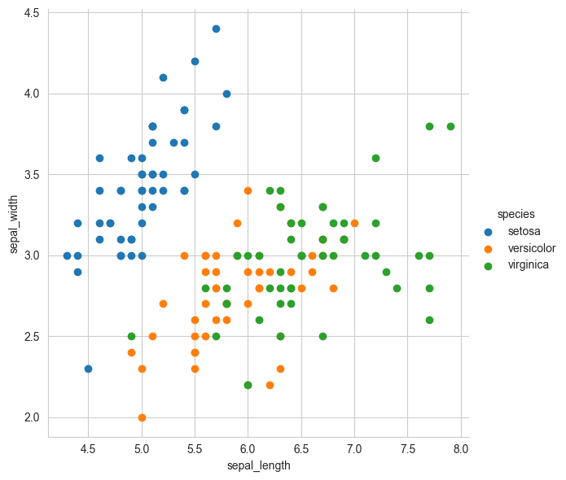
Scatter plot with color-coding for each flower type/class.

Slide 7
Conclusion:
The Iris Flower Classification project has successfully developed and evaluated several machine learning models to automate the process of identifying iris species based on botanical features. Among the models tested, logistic regression emerged as the most effective, achieving an impressive accuracy score of 0.98 on the test dataset. This high accuracy demonstrates the robustness and reliability of the logistic regression model in accurately classifying iris flowers.
The achievement of a 98% accuracy rate indicates that the logistic regression model can be deployed with confidence in real-world applications, such as botanical research, conservation efforts, and horticultural practices. By automating the classification process, this model streamlines tasks that were previously labor-intensive and prone to human error, thus saving time and resources while improving the accuracy of species identification.

Slide 8
Recommendations:
Further Evaluation and Validation: Despite the high accuracy achieved by the logistic regression model, it is essential to conduct further evaluation and validation on additional datasets to ensure its generalizability and robustness across diverse scenarios. This includes testing the model on unseen data collected from different geographical locations or under varying environmental conditions.
* Feature Importance Analysis: Conduct an in-depth analysis of feature importance to understand the contributions of different botanical features (e.g., sepal length, sepal width, petal length, petal width) to the classification process. This analysis can provide valuable insights into the morphological characteristics that are most indicative of iris species, aiding in botanical research and taxonomy studies.
* Model Interpretability: Enhance the interpretability of the logistic regression model by visualizing decision boundaries, coefficients, and probability distributions. This enables stakeholders, including botanists, researchers, and policymakers, to gain a deeper understanding of how the model makes classification decisions and to interpret its outputs accurately.
* Integration with Botanical Databases: Integrate the logistic regression model into existing botanical databases and information systems to support automated species identification and data management. This integration enhances the efficiency of botanical research, facilitates data-driven decision-making, and contributes to the advancement of biodiversity conservation efforts.
* Continuous Monitoring and Maintenance: Implement a system for continuous monitoring and maintenance of the logistic regression model to ensure its performance remains optimal over time. This includes periodic updates, retraining on new data, and monitoring for concept drift or changes in data distribution that may affect model performance.

